Slide 1

Operator Overloading

Slide 2
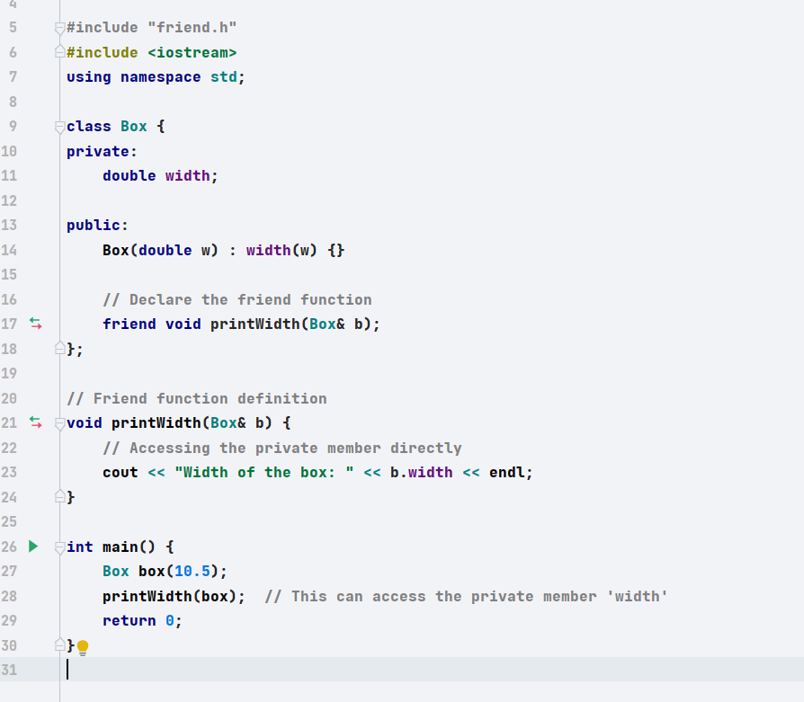
What does friend mean?

Slide 3
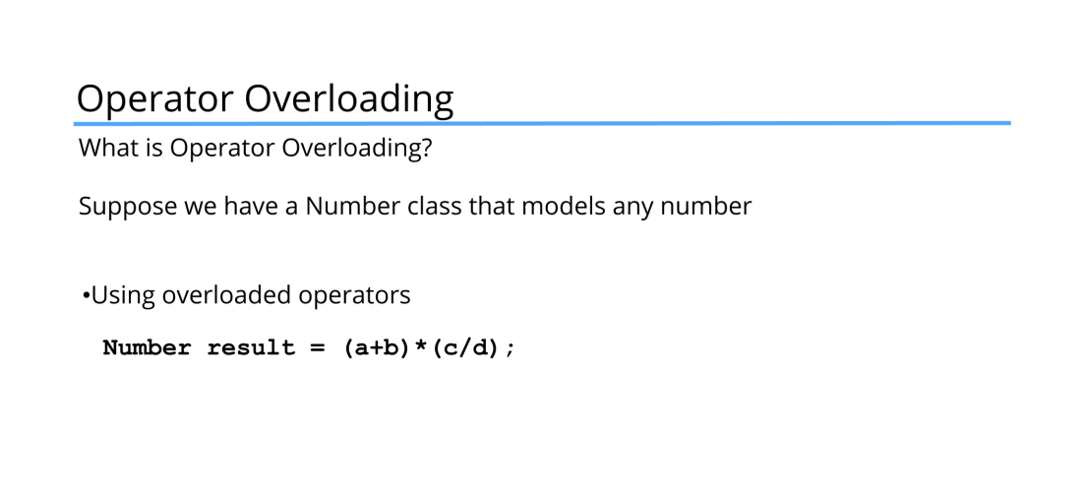
What do we know so far
We know the purpose of classes?
We know why we need to have objects
Any limitations still?

Slide 4
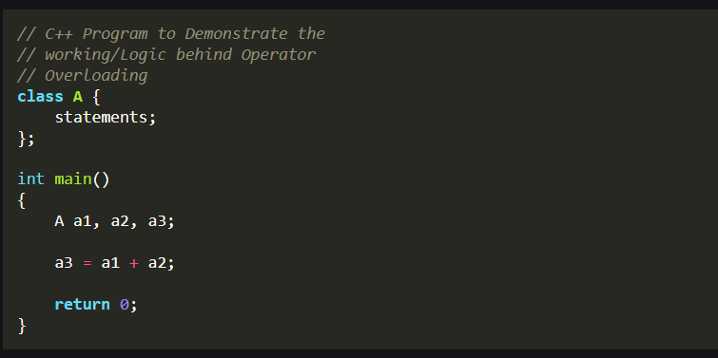
Lets see what's the problem?

Slide 5
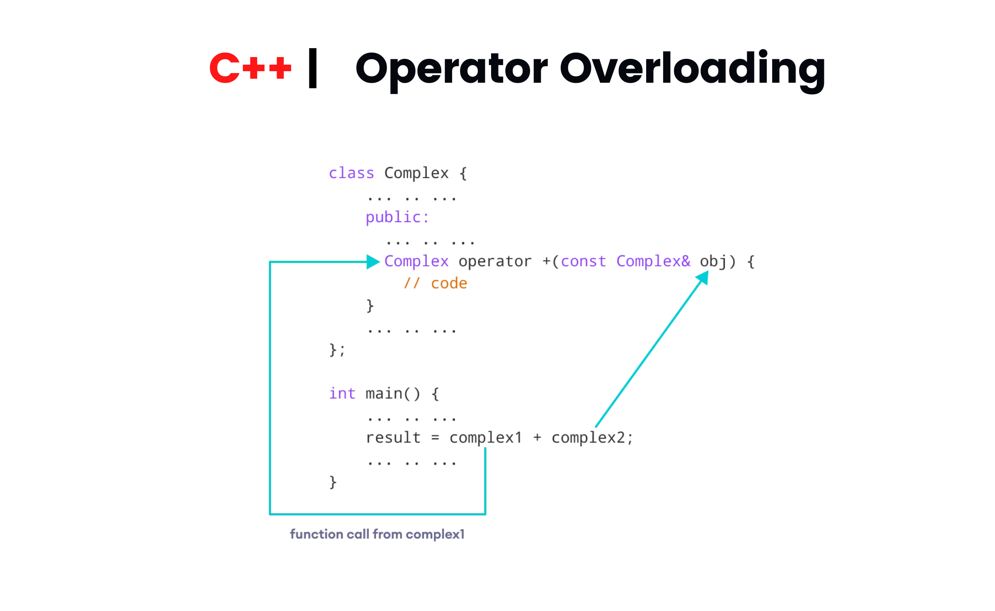

Slide 6
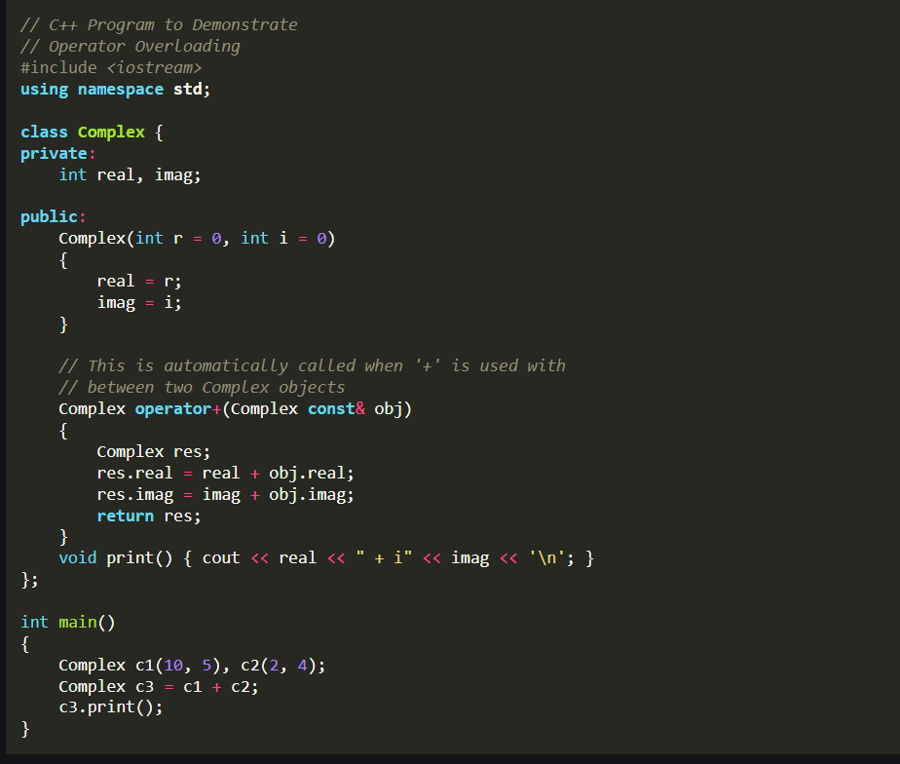

Slide 7
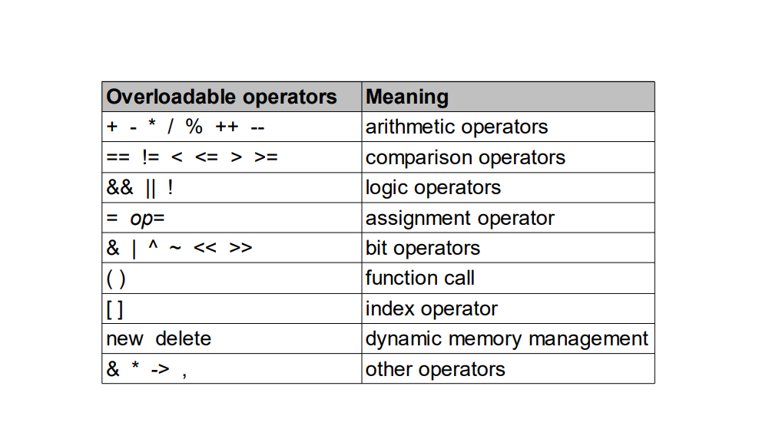

Slide 8
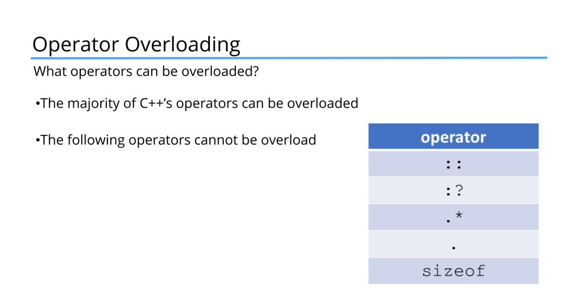

Slide 9
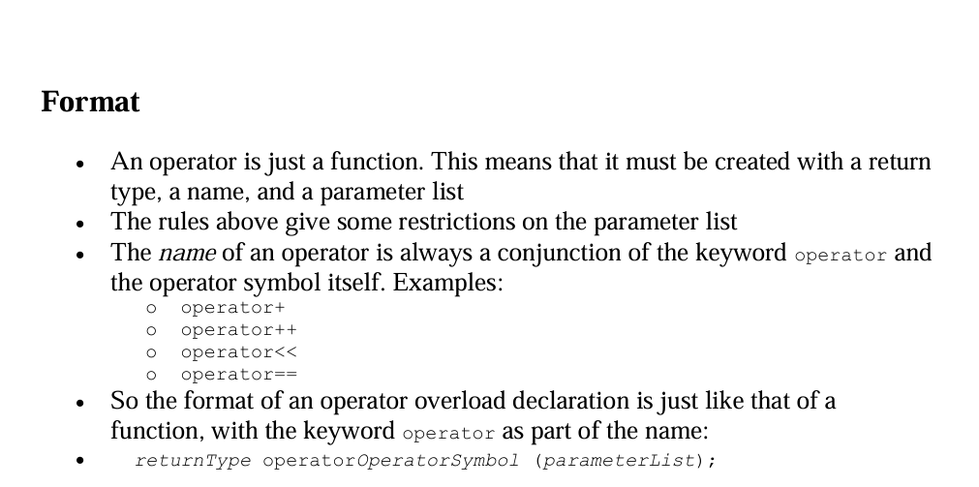
Overloading an operator cannot change its precedence.
Overloading an operator cannot change its associativity.

Slide 10
IDE DAY

